Slide 1
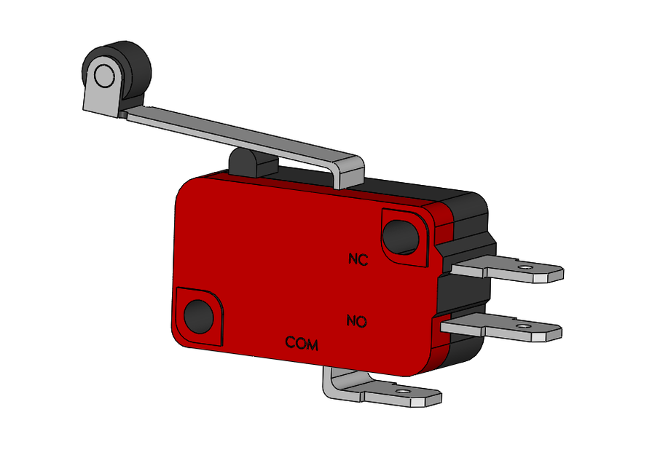
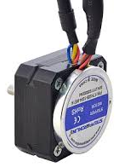
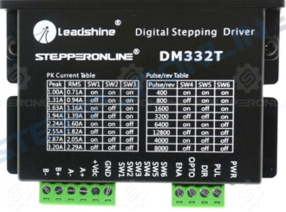
J1 Motor
NC
NO
Limit Switch Output
COM
Ground
3V
Pin
Motor Wires
Encoder
5V
Encoder Wires
Ground
Pin
Pin
Motor Driver

Slide 2
J2 Motor
Length: 12 cm
(remove from shield)
Total Length: 70 cm
NC
NO
Limit Switch Output
COM
Ground
3V
Pin
Motor Wires
Encoder
5V
Encoder Wires
Ground
Pin
Pin
Motor Driver
Add Extension: 34 cm

Slide 3
J3 Motor
Length: 25 cm
(remove from shield)
Total Length: 120 cm
NC
NO
Limit Switch Output
COM
Ground
3V
Pin
Motor Wires
Encoder
5V
Encoder Wires
Ground
Pin
Pin
Motor Driver
Add Extension: 50 cm

Slide 4
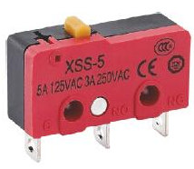
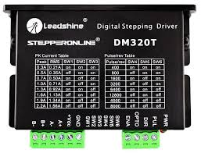
J4 Motor
Length: 17 cm
(remove from shield)
Total Length: 117 cm
NC
NO
Limit Switch Output
COM
Ground
3V
Pin
Motor Wires
Encoder
5V
Encoder Wires
Ground
Pin
Pin
Motor Driver
Add Extension: 55 cm

Slide 5
J5 Motor
Total Length: 102 cm
Total Length: 124 cm
NC
NO
Limit Switch Output
COM
Ground
3V
Pin
Motor Wires
Encoder
5V
Encoder Wires
Ground
Pin
Pin
Motor Driver
Add Extension: 75 cm

Slide 6
J6 Motor
Length: 10 cm
(remove from shield)
Total Length: 145 cm
NC
NO
Limit Switch Output
COM
Ground
3V
Pin
Motor Wires
Encoder
5V
Encoder Wires
Ground
Pin
Pin
Motor Driver
Add Extension: 100 cm

